Slide 1
Common seasonal dermatosis
Dr. L.Yousefkhani
MD. Dermatologist

Slide 2
Cercarial Dermatitis (Swimmer’s Itch)
What is cercarial dermatitis?
Cercarial dermatitis, also known as swimmer’s itch, is an itchy rash caused by a tiny parasitic worm. It’s contracted by swimming or wading in infested fresh water lakes or ponds.

Slide 4
What are the symptoms of swimmer’s itch?
tingling, burning, or itching on your exposed skin small, red pimples blisters, on rare occasions The itching can last up to several days.
The rash is only located on skin that was exposed to the water. It’s important to try not to scratch, as scratching can lead to skin infection.
The itch is an allergic reaction to the parasite, and the more frequently you swim in contaminated waters, the worse your symptoms may be each time. Also, some people may be more sensitive to the parasite.

Slide 5
How is swimmer’s itch diagnosed?
Cercarial dermatitis may be hard to distinguish from other skin reactions, such as insect bites, poison ivy, jellyfish stings, or bacterial infections. There is no specific test for it.

Slide 6
How is it treated?
Most of the time, you can use home treatments to calm the itch from swimmer’s rash.
anti-itch lotion or corticosteroid cream
cool compresses

Slide 7
Paederus dermatitis
Paederus dermatitis, also known as dermatitis linearis or blister beetle dermatitis is a peculiar irritant contact dermatitis characterized by erythematous and bullous lesions of sudden onset on exposed areas of the body.

Slide 9
Etiopathogenesis
The genus Paederus belongs to family Staphyllinidae , order Coleoptae , class Insecta and consists of over 622 species which are distributed worldwide.
Paederus beetles live in moist habitats. Paederus beetles are beneficial to agriculture because they eat crop pests.
Hemolymph of the beetle contains paederine which is released on crushing of the insect onto the skin.

Slide 10
clinical features
The incidence of cases is more common in the period that immediately follows the rainy season.
The lesions are erythematous and edematous which may be linear, giving a whiplash appearance. The vesicles generally appear towards the center of the plaque. The vesicles turn into pustules quite frequently.
The signs appear after 24 to 48h of contact and take a week or more to disappear.

Slide 11
clinical features
A striking feature is the presence of "kissing lesions" that occur whenever apposition of damaged areas to previously intact skin is possible, e.g., flexure of the elbow, adjacent surfaces of the thighs.
Diffuse erythematous and desquamative lesions which predominantly occur on the upper body and face.

Slide 12
clinical features
Complications include postinflammatory hyperpigmentation, secondary infections, and extensive exfoliating and ulcerating dermatitis requiring hospitalization.
Ocular and genital involvement .
Ocular involvement usually presents with unilateral periorbital dermatitis, or keratoconjunctivitis, which has been named the Nairobi eye.

Slide 14
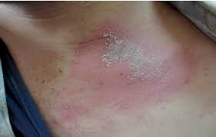
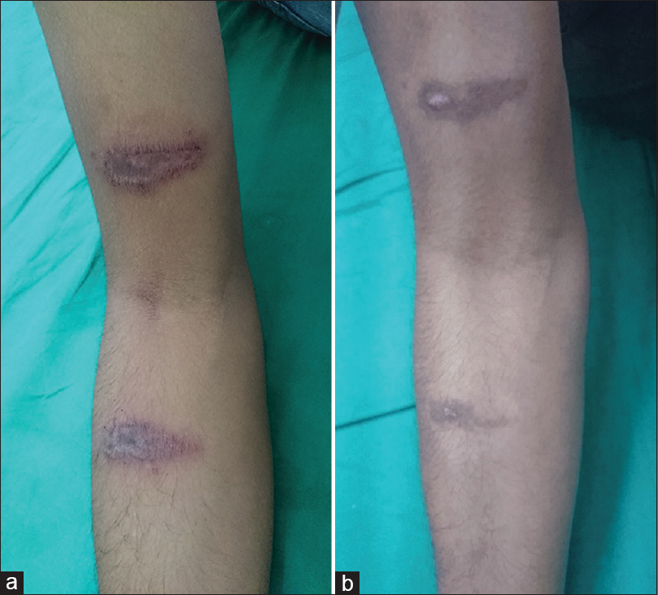

Slide 15
Differential diagnosis
herpes simplex
herpes zoster
liquid burns
acute allergic or irritant contact dermatitis
millipede dermatitis
phytophotodermatitis

Slide 16
Treatment
initial washing with soap and water
cold wet compresses
topical steroid
antibiotic, If secondarily infected

Slide 17
Mite induced dermatitis
Mites are small arachnids that range from 0.1 to 2 mm in length. Tens of thousands of species exist worldwide. The majority of mites are free-living, but thousands of species parasitize animals or plants.
Cutaneous reactions to mites are common and include papular, papulovesicular, bullous, urticarial, and morbilliform eruptions, most often affect the lower legs, skin at the edges of underwear, and the genital region

Slide 19
treatment
Scraping, tape stripping, or vigorous washing with soap and water
topical antipruritics such as menthol
topical anesthetics such as pramoxine
Potent topical corticosteroid
Intralesional corticosteroid injections and excision of pruritic nodules
Bullous and excoriated lesions can develop secondary infections, and appropriate wound care is important.

Slide 20
Leptospirosis
Leptospirosis is an infectious disease of humans and animals that is caused by pathogenic spirochetes of the genus Leptospira .
It is considered the most common zoonosis in the world and is associated with rodents.

Slide 21
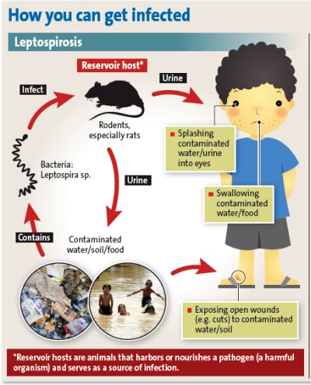

Slide 22
Signs and symptoms
It is characterized by sudden onset of the following:
Fever (38-40°C)
Rigors
Headache, retro-orbital pain, photophobia
Muscle pain localized to the calf and lumbar areas
Conjunctival suffusion
Dry cough
Nausea and vomiting, diarrhea
More severe disease manifests as icteric leptospirosis, also known as Weil disease, with the following features:
Icterus or frank jaundice
Renal failure with oliguria
Hemorrhagic features
Systemic inflammatory syndrome or shock

Slide 23
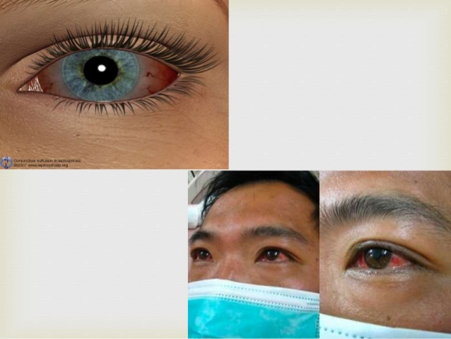
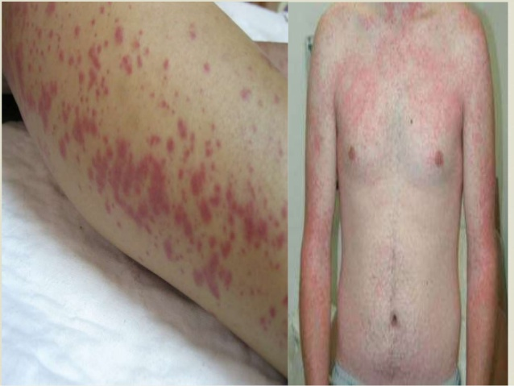

Slide 24
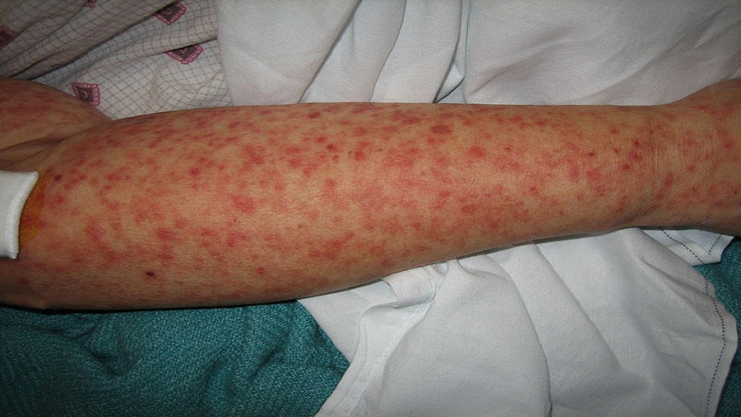

Slide 25
Diagnosis
Laboratory studies used to screen for the diagnosis of leptospirosis include the following:
- Leptospira IgM ELISA or IgG ELISA
- PCR of blood, urine, and cerebrospinal fluid (CSF)
Laboratory studies used to confirm the diagnosis of leptospirosis include the following:
- Microscopic agglutination testing (MAT)
- Single titer ≥1:200 or 4-fold rise in serum drawn between the first and fourth week of illness
- DNA PCR of blood, urine, CSF, tissue
- Culture of leptospires from body fluids
Studies to determine the extent of organ involvement and severity of complications:
- Complete blood cell (CBC) count
- Renal function studies
- Coagulation studies
- Liver function studies
- CSF analysis
- Chest radiography
- Biliary tract ultrasonography
- Electrocardiography (ECG)

Slide 26
Management
Antibiotic therapy in the treatment of mild leptospirosis is typically unnecessary, since it is often self-limited, and most cases resolve without medical attention.
Oral antibiotics shorten the course of illness. If used, antibiotic treatment may include the following:
1. Doxycycline
2. Ampicillin or amoxicillin
3. Azithromycin or clarithromycin
4. Fluoroquinolone such as ciprofloxacin or levofloxacin
Antibiotics for leptospirosis requiring hospitalization:
1. Intravenous penicillin G
2. Intravenous third-generation cephalosporins (cefotaxime and ceftriaxone)
3. Intravenous ampicillin or amoxicillin
4. Intravenous erythromycin

Slide 27
Dermatoses among paddy field workers

Slide 30
Thanks for your attention

